Slide 1
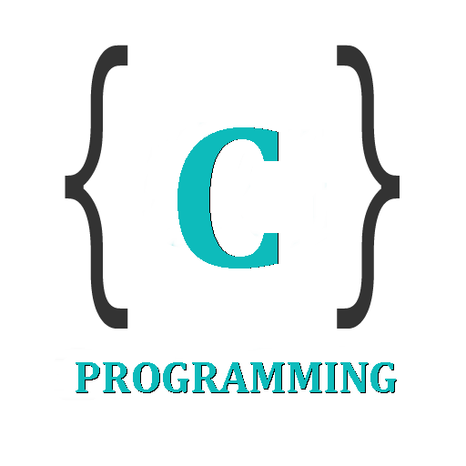

IT 105: Introduction to Programming
Dr. Manish Khare
Dr. Saurabh Tiwari
Lecture 17

Slide 2
Arrays in C
When we work with large number of data values we need that many number of different variables. As the number of variables increases, the complexity of the program also increases and so the programmers get confused with the variable names. There may be situations where we need to work with large number of similar data values.
To make this work more easy, C programming language provides a concept called "Array".

Slide 3
An array is a special type of variable used to store multiple values of same data type at a time.
An array is a collection of similar data items stored in continuous memory locations with single name.

Slide 4
Arrays
Array is a container which can hold a fix number of items and these items should be of the same type. Most of the data structures make use of arrays to implement their algorithms. Following are the important terms to understand the concept of Array.
  Element − Each item stored in an array is called an element.
  Index − Each location of an element in an array has a numerical index, which is used to identify the element.

Slide 5
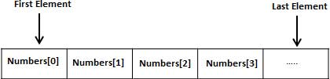
Arrays
All arrays consist of contiguous memory locations. The lowest address corresponds to the first element and the highest address to the last element.
Instead of declaring individual variables, such as number0, number1, ..., and number99, you declare one array variable such as numbers and use numbers[0], numbers[1], and ..., numbers[99] to represent individual variables. A specific element in an array is accessed by an index.

Slide 6
Arrays Definition
A set of pairs <index, value> where for each value of index there is a value from the set item. Index is a finite ordered set of one or more dimensions.
For example, {0,1,…..n-1} for one-dimension, {(0,0),(0,1),(0,2),(1,0),(1,1),(1,2),(2,0),(2,1),(2,2)} for two-dimensions, etc.

Slide 7
Array Representation
Functions:
  for all A € Array, i € index, x € item, j, size € integer
Array Create(j,list): return an array of j dimensions where list is a j-tuple whose ith element is the the size of the ith dimension. Items are undefined.
Item Retrieve (A,i): if (i € index) return the item associated with index value i in Array A else return error
Array Store(A,i,x): if (i in index)
    return an array that is identical to array A except the new pair <i,x> has been inserted else return error

Slide 8
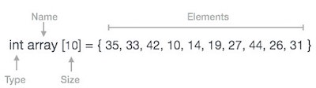
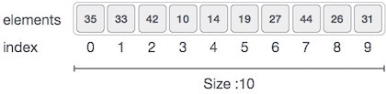
Arrays Representation
Arrays can be declared in various ways in different languages. For illustration, let's take C array declaration.
As per the above illustration, following are the important points to be considered.
  Index starts with 0.
  Array length is 10 which means it can store 10 elements.
  Each element can be accessed via its index. For example, we can fetch an element at index 6 as 9.

Slide 9
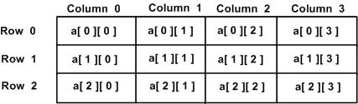
Arrays Representation
A two-dimensional array can be considered as a table which will have x number of rows and y number of columns. A two-dimensional array a, which contains three rows and four columns can be shown as follows −
Thus, every element in the array a is identified by an element name of the form a[ i ][ j ], where 'a' is the name of the array, and 'i' and 'j' are the subscripts that uniquely identify each element in 'a'.

Slide 10
Arrays – Basic Operations
Following are the basic operations supported by an array.
  Traverse − print all the array elements one by one.
  Insertion − Adds an element at the given index.
  Deletion − Deletes an element at the given index.
  Search − Searches an element using the given index or by the value.
  Update − Updates an element at the given index.

Slide 11
Traverse Operation
  In traversing operation of an array, each element of an array is accessed exactly for once for processing. This is also called visiting of an array.
Insertion Operation
  Insert operation is to insert one or more data elements into an array. Based on the requirement, new element can be added at the beginning, end or any given index of array.
Deletion Operation
  Deletion refers to removing an existing element from the array and re-organizing all elements of an array.
Search Operation
  You can perform a search for array element based on its value or its index.
Update Operation
  Update operation refers to updating an existing element from the array at a given index.

Slide 12
Declaring Arrays
To declare an array in C/C++, a programmer specifies the type of the elements and the number of elements required by an array as follows −
  datatype arrayName [ arraySize ];
This is called a single-dimensional array. The arraySize must be an integer constant greater than zero and type can be any valid C data type. For example, to declare a 10-element array called balance of type double, use this statement −
  double balance[10];
Here balance is a variable array which is sufficient to hold up to 10 double numbers.

Slide 13
Syntax for creating an array with size and initial values
  datatype arrayName [ size ] = {value1, value2, ...} ;
Syntax for creating an array without size and with initial values
  datatype arrayName [ ] = {value1, value2, ...} ;
In the above syntax, the datatype specifies the type of values we store in that array and size specifies the maximum number of values that can be stored in that array.

Slide 14
Initializing Arrays
You can initialize an array in C either one by one or using a single statement as follows −
  double balance[5] = {1000.0, 2.0, 3.4, 7.0, 50.0};
The number of values between braces { } cannot be larger than the number of elements that we declare for the array between square brackets [ ].
If you omit the size of the array, an array just big enough to hold the initialization is created. Therefore, if you write −
  double balance[] = {1000.0, 2.0, 3.4, 7.0, 50.0};

Slide 15

Example
int a [3] ;
Here, the compiler allocates 6 bytes of continuous memory locations with single name 'a' and tells the compiler to store three different integer values (each in 2 bytes of memory) into that 6 bytes of memory.
For the above declaration the memory is organized as follows...

Slide 16
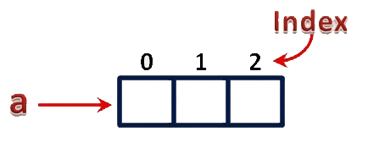
In the above memory allocation, all the three memory locations has a common name 'a'. So the accession of individual memory location is not possible directly. Hence compiler not only allocates the memory but also assigns a numerical reference value to every individual memory location of an array. This reference number is called as "Index" or "subscript" or "indices". Index values for the above example is as follows...

Slide 17
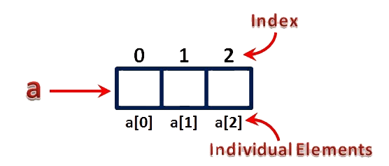
Accessing Individual Elements of an Array
The individual elements of an array are identified using the combination of 'arrayName' and 'indexValue'. We use the following general syntax to access individual elements of an array...
  arrayName [ indexValue ] ;
For the above example the individual elements can be denoted as follows...

Slide 18
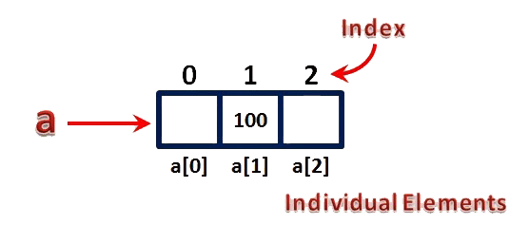
For example, if we want to assign a value to the second memory location of above array 'a', we use the following statement...
  a [1] = 100 ;
The result of above assignment statement is as follows...

Slide 19
Initializing Two-Dimensional Arrays
Multidimensional arrays may be initialized by specifying bracketed values for each row. Following is an array with 3 rows and each row has 4 columns.
  int a[3][4] = { {0, 1, 2, 3} , /* initializers for row indexed by 0 */
{4, 5, 6, 7} , /* initializers for row indexed by 1 */
{8, 9,10, 11} /* initializers for row indexed by 2 */ };
The nested braces, which indicate the intended row, are optional. The following initialization is equivalent to the previous example −
  int a[3][4] = {0,1,2,3,4,5,6,7,8,9,10,11};

Slide 20
Accessing Two-Dimensional Array Elements
An element in a two-dimensional array is accessed by using the subscripts, i.e., row index and column index of the array. For example −
  int val = a[2][3];
The above statement will take the 4th element from the 3rd row of the array.

Slide 21
Exercise
1. Program for declaration, assignment and accessing arrays.
2. Program for handle a two-dimensional array.

Slide 22
1-Dimensional Array

Slide 23
Insertion Operation in Array
Insert operation is to insert one or more data elements into an array. Based on the requirement, a new element can be added at the beginning, end, or any given index of array.
Algorithm
  Let LA be a Linear Array (unordered) with N elements and K is a positive integer such that K<=N. Following is the algorithm where ITEM is inserted into the K^{th} position of LA −
    1. Start
    2. Set J = N
    3. Set N = N+1
    4. Repeat steps 5 and 6 while J >= K
    5. Set LA[J+1] = LA[J]
    6. Set J = J-1
    7. Set LA[K] = ITEM
    8. Stop

Slide 24
Exercise
3. Program for Insertion operation in Arrays

Slide 25
We have learnt how the insertion operation works. It is not always necessary that an element is inserted at the end of an array. Following can be a situation with array insertion −
  Insertion at the beginning of an array
  Insertion at the given index of an array
  Insertion after the given index of an array
  Insertion before the given index of an array

Slide 26
Delete Operation in Array
Deletion refers to removing an existing element from the array and re-organizing all elements of an array.
Algorithm
  Consider LA is a linear array with N elements and K is a positive integer such that K<=N. Following is the algorithm to delete an element available at the K^{th} position of LA.
    1. Start
    2. Set J = K
    3. Repeat steps 4 and 5 while J < N
    4. Set LA[J] = LA[J + 1]
    5. Set J = J+1
    6. Set N = N-1
    7. Stop

Slide 27
Example
4. Program for Deletion operation in Arrays

Slide 28
Search Operation in Array
You can perform a search for an array element based on its value or its index.
Algorithm
  Consider LA is a linear array with N elements and K is a positive integer such that K<=N. Following is the algorithm to find an element with a value of ITEM using sequential search.
    1. Start
    2. Set J = 0
    3. Repeat steps 4 and 5 while J < N
    4. IF LA[J] is equal ITEM THEN GOTO STEP 6
    5. Set J = J +1
    6. PRINT J, ITEM
    7. Stop

Slide 29
Example
5. Program for Search operation in Arrays

Slide 30
Update Operation in Array
Update operation refers to updating an existing element from the array at a given index.
Algorithm
  Consider LA is a linear array with N elements and K is a positive integer such that K<=N. Following is the algorithm to update an element available at the K^{th} position of LA.
    1. Start
    2. Set LA[K-1] = ITEM
    3. Stop

Slide 31
Example
6. Program for Update operation in Arrays

Slide 32
Find Largest Element of an Array
Calculate Average Using Arrays

Slide 33
2-Dimensional Array

Slide 34
Multi Dimensional Array
An array of arrays is called as multi dimensional array. In simple words, an array created with more than one dimension (size) is called as multi dimensional array. Multi dimensional array can be of two dimensional array or three dimensional array or four dimensional array or more...
Most popular and commonly used multi dimensional array is two dimensional array. The 2-D arrays are used to store data in the form of table. We also use 2-D arrays to create mathematical matrices.

Slide 35
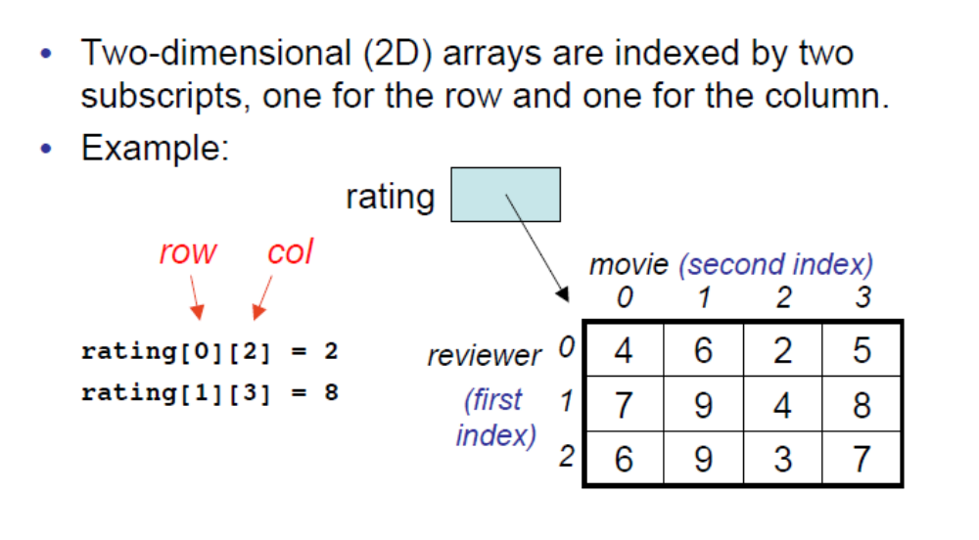
2-Dimensional Arrays

Slide 36
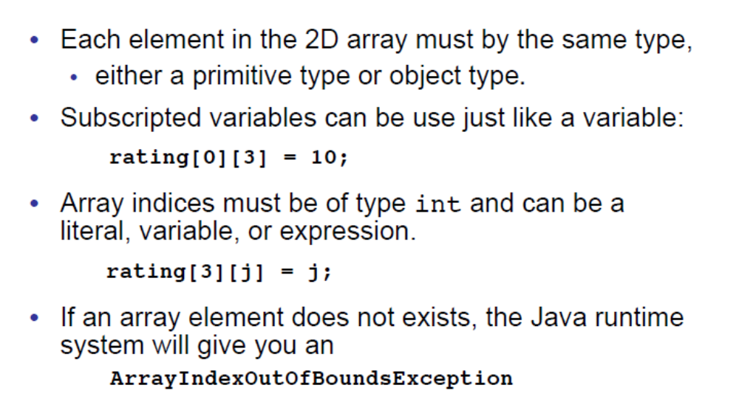
Similarity with 1-D Arrays

Slide 37
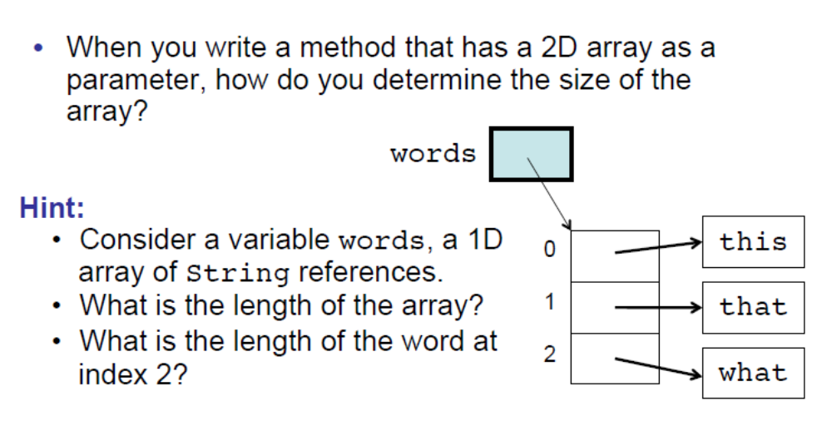
Size of 2-D Arrays

Slide 38
Addition of two 2-D Array
Multiplication of two 2-D Array
Traverse a 2-D Array
Transpose a 2-D Array

Slide 39
Addition of two 2-D Array
Add ( ):
  Description: Here A is a two – dimensional array with M rows and N columns and B is a two – dimensional array with X rows and Y columns. This algorithm adds these two arrays.
1. If (M ≠ X) or (N ≠ Y) Then
2. Print: Addition is not possible.
3. Exit
[End of If]
  4. Repeat For I = 1 to M
    5. Repeat For J = 1 to N
    6. Set C[I][J] = A[I][J] + B[I][J]
    [End of Step 5 For Loop]
    [End of Step 6 For Loop]
    7. Exit

Slide 40
First, we have to check whether the rows of array A are equal to the rows of array B or the columns of array A are equal to the columns of array B. if they are not equal, then addition is not possible and the algorithm exits. But if they are equal, then first for loop iterates to the total number of rows i.e. M and the second for loop iterates to the total number of columns i.e. N. In step 6, the element A[I][J] is added to the element B[I][J] and is stored in C[I][J] by the statement:
    C[I][J] = A[I][J] + B[I][J]
7. Program for Addition of two matrices

Slide 41
Multiplication of two 2-D Array
Multiply ( ):
  Description: Here A is a two – dimensional array with M rows and N columns and B is a two – dimensional array with X rows and Y columns. This algorithm multiplies these two arrays.
    1. If (M ≠ Y) or (N ≠ X) Then
    2. Print: Multiplication is not possible.
    3. Else
4. Repeat For I = 1 to N
5. Repeat For J = 1 to X
6. Set C[I][J] = 0
7. Repeat For K = 1 to Y
8. Set C[I][J] = C[I][J] + A[I][K] * B[K][J]
[End of Step 7 For Loop]
[End of Step 5 For Loop]
[End of Step 4 For Loop]
[End of If]
9. Exit

Slide 42
First we check whether the rows of A are equal to columns of B or the columns of A are equal to rows of B. If they are not equal, then multiplication is not possible. But, if they are equal, the first for loop iterates to total number of columns of A i.e. N and the second for loop iterates to the total number of rows of B i.e. X. In step 6, all the elements of C are set to zero. Then the third for loop iterates to total number of columns of B i.e. Y. In step 8, the element A[I][K] is multiplied with B[K][J] and added to C[I][J] and the result is assigned to C[I][J] by the statement:
    C[I][J] = C[I][J] + A[I][K] * B[K][J]
8. Program for Multiplication of two matrices

Slide 43
Traverse a 2-D Array
Traverse ( ):
Description: Here A is a two – dimensional array with M rows and N columns. This algorithm traverses array A and applies the operation PROCESS to each element of the array.
    1. Repeat For I = 1 to M
    2. Repeat For J = 1 to N
3. Apply PROCESS to A[I][J]
    [End of Step 2 For Loop]
    [End of Step 1 For Loop]
    4. Exit

Slide 44
The first for loop iterates from 1 to M i.e. to the total number of rows and the second for loop iterates from 1 to N i.e. to the total number of columns. In step 3, it applies the operation PROCESS to the elements of the array A.
9. Program for Traverse of matrices

Slide 45
Transpose a 2-D Array
Transpose ( ):
Description: Here A is a two – dimensional array with M rows and N columns. This algorithm transposes the array.
    1. Repeat For I = 1 to M
2. Repeat For J = 1 to N
3. Set B[J][I] = A[I][J]
[End of Step 2 For Loop]
[End of Step 1 For Loop]
4. Exit

Slide 46
The first for loop iterates from 1 to M i.e. total number of rows and second for loop iterates from 1 to N i.e. total number of columns. In step 3, the element at location A[I][J] is assigned to B[J][I] by the statement B[J][I] = A[I][J].
10. Program for Transpose of matrices

